Slide 1
22 Jul 2022 09:30
Telephone Conference – Interim Management Statement Q2 2022
Isabelle Ducellier. CEO
Alexander Kotsinas. CFO

Slide 2
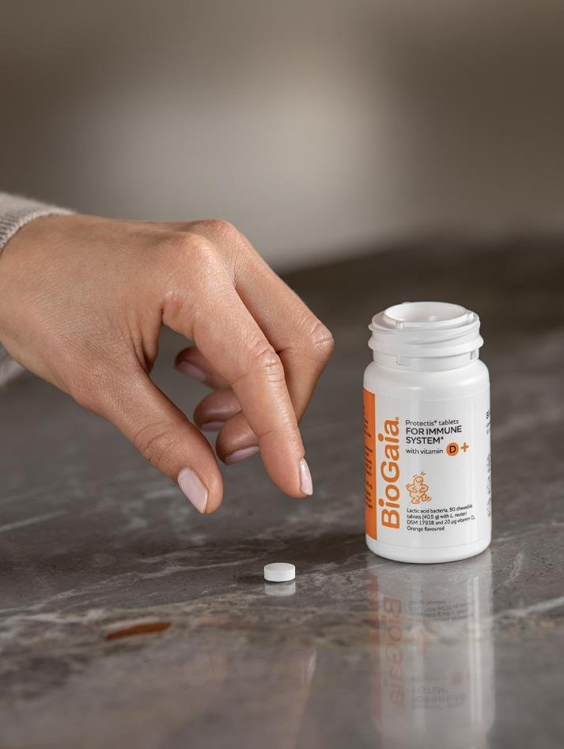
Q2 2022 – Executive Summary
+42% sales increase driven by continued strong demand in Europe
Record revenue (288 MSEK) and operating profit (101 MSEK, +46%)
Strong operating cash flow

Slide 3
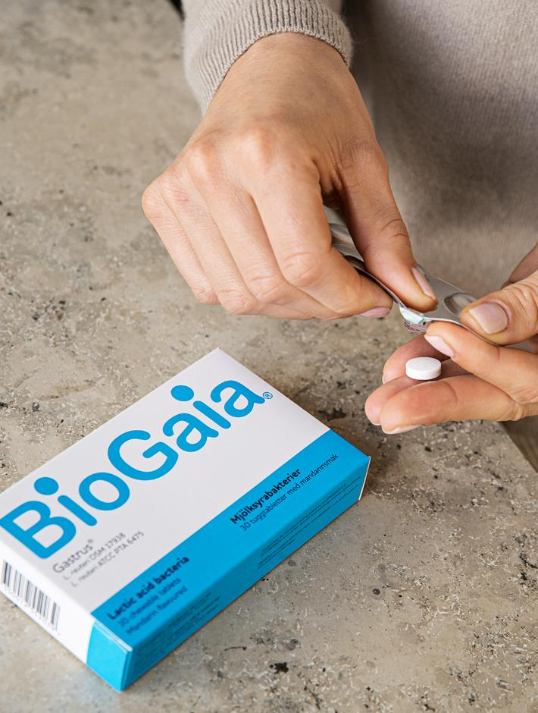
Key Events
25th of April: Result for the first quarter exceed market expectations
6th of May: Record date for share split idetermined as 19th of May 2022
17th of May: BioGaia starts its own distribution in Canada
8th of June: Exclusive agreement in South Korea for baby gut health range
1st of July: BioGaia launches probiotic product to support children’s respiratory health
14th of July: Result for the second quarter exceed market expectations
Launches
Distributor | Country | Product
Abbott | Ecuador | BioGaia Protectis drops vitamin D
Abbott | Ecuador | BioGaia Protectis tabs vitamin D
Ethical Nutrition | Argentina | BioGaia Protectis drops
Ethical Nutrition | Argentina | BioGaia Protectis tabs
Interbat | Indonesia | BioGaia Protectis tabs vitamin D
Denomics | South Korea | BioGaia Prodentis Kids
Unilab | Philippines | BioGaia Minipack
Dr Mums | China | BioGaia Pharax
BG Distribution | Hungary | BioGaia Prodentis tabs
3

Slide 4
Sales per Segment (MSEK)
Proportion Sales by segment
Total sales for the quarter increased with +42% (+33% excluding currency effects)
Pediatrics sales increased with +44% mainly thanks to increased sales of Protectis Drops in EMEA and Americas
Adult sales increased with +33% mainly thanks to increased sales of Protectis Tablets in EMEA
Q2 2022
 | Q2 | Q2 | Change | YTD | YTD | Change
 | 2022 | 2021 | % | 2022 | 2021 | %
Total Pediatrics | 233 | 161 | 44% | 455 | 323 | 41%
Total Adult Health | 54 | 41 | 33% | 115 | 80 | 44%
Other | 1 | 1 | 6% | 2 | 3 | -36%
Total | 288 | 203 | 42% | 572 | 405 | 41%
YTD
Pediatrics
Adult
Other

Slide 5
Sales per Geographical Market (MSEK)
Proportion Sales by Region
EMEA: sales increased mainly in Italy and France APAC: sales increased mainly in South Korea and China
Americas: sales increased mainly in the US and Canada
Q2 2022
 | Q2 | Q2 | Change | YTD | YTD | Change
 | 2022 | 2021 | % | 2022 | 2021 | %
EMEA | 130 | 70 | 86% | 280 | 164 | 71%
APAC | 63 | 55 | 16% | 110 | 97 | 13%
Americas | 95 | 79 | 21% | 182 | 144 | 26%
Total | 288 | 203 | 42% | 572 | 405 | 41%
YTD
EMEA
Americas
APAC

Slide 6
Gross Margin per Segment
Gross margins slightly decreased due to product mix effects and campaigns
 | Q2 | Q2 |  | YTD | YTD
 | 2022 | 2021 |  | 2022 | 2021
Total Pediatrics | 73% | 75% |  | 73% | 75%
Total Adult health | 63% | 70% |  | 65% | 65%
Total | 71% | 74% |  | 71% | 73%

Slide 7
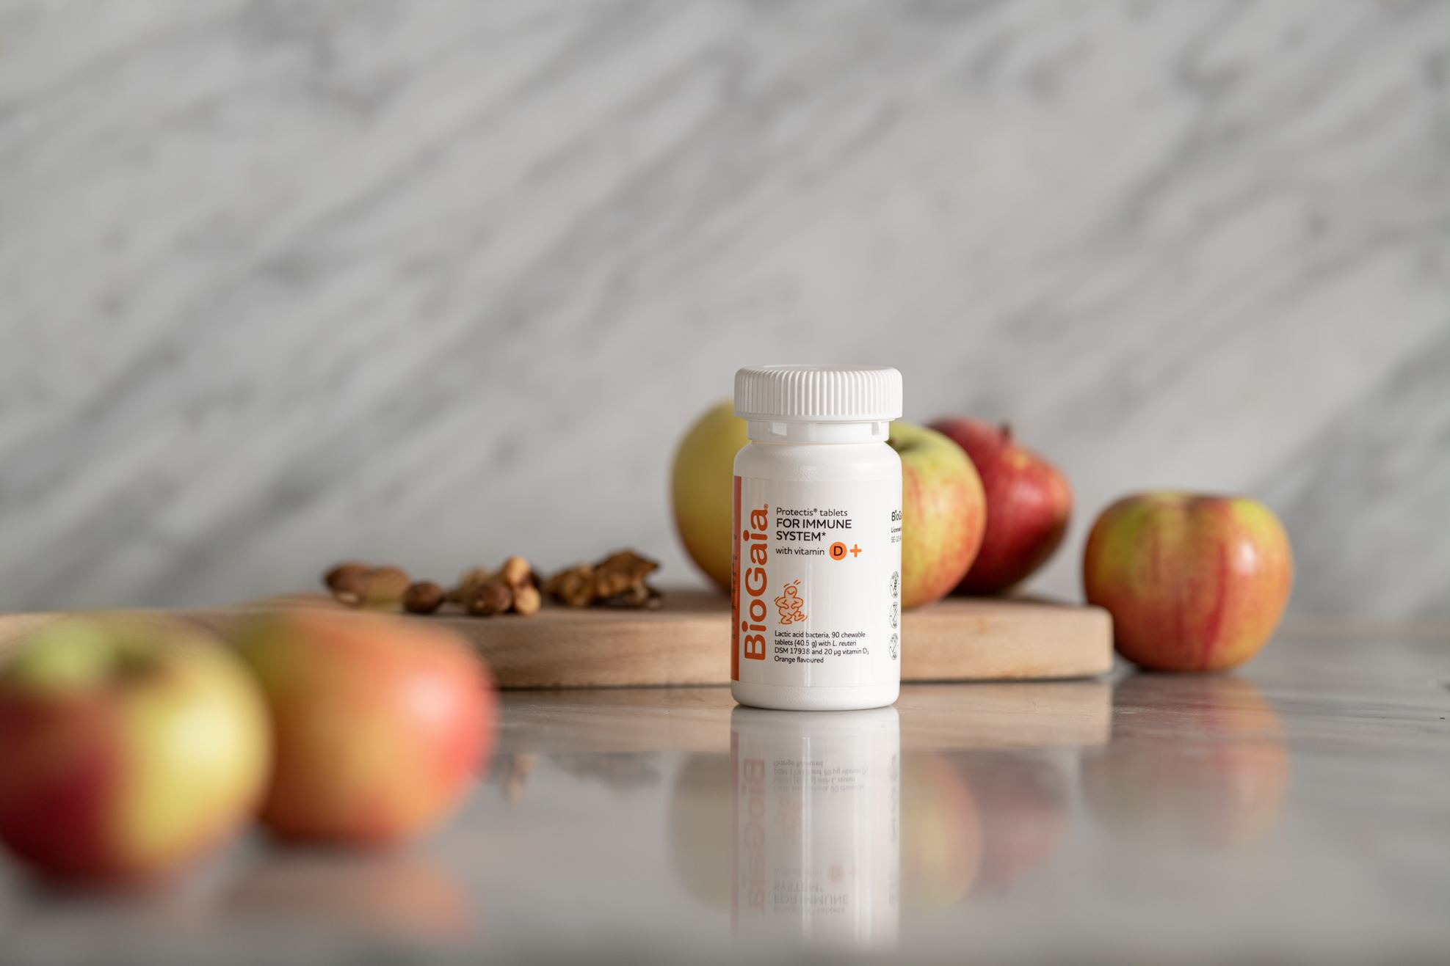
Financials
Alexander Kotsinas. CFO

Slide 8
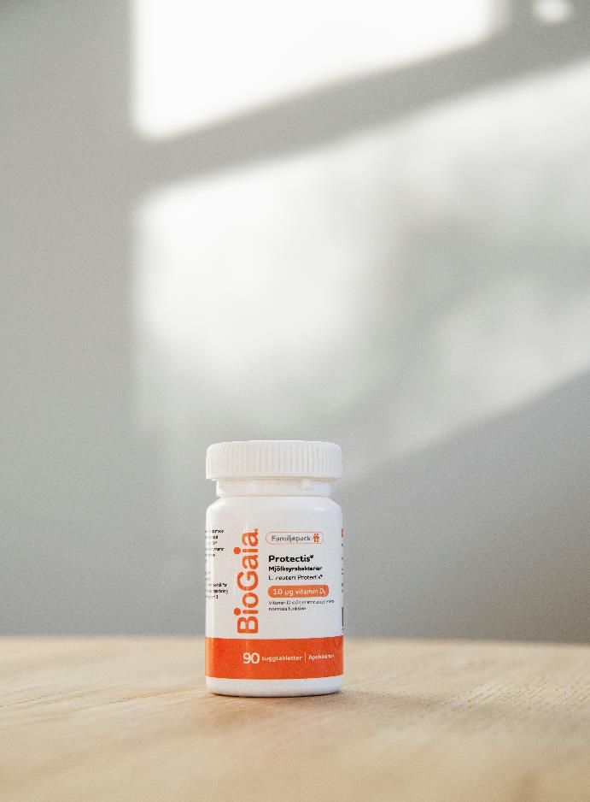
Q2 FINANCIALS
Revenues were 288 (203) MSEK, +42% growth. Organic growth of 26 % (growth excluding currency and acquisitions)
EBIT was 101 (69) MSEK (46% growth)
EBIT margin of 35% (34%)
Earnings per share were 0.78 (0.54) SEK
Operating cash flow at 87 (56) MSEK
Net sales and EBIT margin (%)
EBIT margin (%)
2019
2020
2021
2022

Slide 9
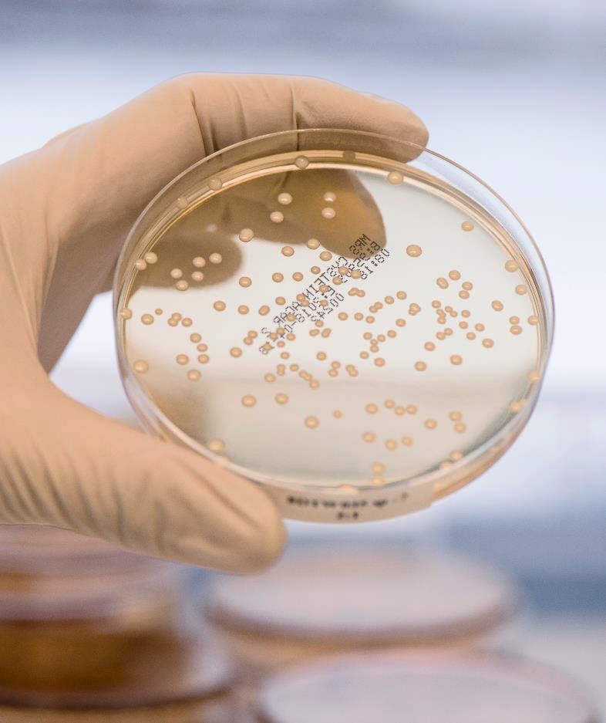
Q2 SALES BRIDGE
+42%
vs prior
Q2
YTD
 | in MSEK | Change (%)
2021 | 203
Organic Growth | +52 | +26%
Acquisitions | +14 | +7%
Currency | +19 | +9%
2022 | 288 | +42%
in MSEK | Change (%)
405
+101 | +25%
+29 | +7%
+37 | +9%
572 | +41%

Slide 10
GROUP OPEX
Q2 BRIDGE
Total OPEX +28%. OPEX excluding Acquisitions +1%
Sales costs increased mainly due to Everidis (22.3 MSEK) but also due to increased activities.
Admin costs flat and included costs for evaluation of acquisition candidates 0.3 (0,0 MSEK) and impairment of right-of-use assets linked to a rental contract for premises in Lund -1.7 (0.0 MSEK)
R&D costs excluding MetaboGen and BioGaia Pharma increased slightly due to phasing of costs for clinical studies
Other costs at -14,2 MSEK due to positive currency effects
+23
GROUP P&L (MSEK) | Q2 2022 | Q2 2021 | Change | YTD 2022 | YTD 2021 | Change
TOTAL OPEX | 104,6 | 81,6 | 28% | 211,6 | 162,6 | 30%
TOTAL OPEX excl Restructuring ¹ | 106,0 | 81,6 | 30% | 208,3 | 152,6 | 37%
TOTAL OPEX excl Acquisitions ² | 82,3 | 81,6 | 1% | 168,3 | 162,6 | 4%
OPEX Core | 100,0 | 74,8 | 34% | 202,2 | 149,9 | 35%
Sales | 83,2 | 44,0 | 89% | 155,3 | 87,3 | 78%
Admin | 7,8 | 7,7 | 1% | 18,8 | 23,4 | -19%
R&D | 23,3 | 21,3 | 9% | 43,4 | 42,6 | 2%
Other | -14,2 | 1,8 | -881% | -15,3 | -3,3 | 359%
OPEX Non-Core (MetaboGen+BioGaia Pharma) | 4,6 | 6,8 | -32% | 9,4 | 12,7 | -26%
¹ excl. restructuring costs and excluding costs evaluation of acquisition candidates
² excl BioGaia USA

Slide 11
GROUP PROFIT AND LOSS
Q2 BRIDGE
Sales +42% (+33% excl. currency, +26% excl. currency and excl. acquisitions)
OPEX +28% (+1% excl. acquisitions)
EBIT +46% and EBIT Margin 35%
Adjusted EBIT +44% and Adjusted EBIT Margin 35%
+32
GROUP P&L (MSEK) | Q2 2022 | Q2 2021 | Change | YTD 2022 | YTD 2021 | Change
Sales | 288 | 203 | 42% | 572 | 405 | 41%
Gross Profit | 206 | 151 | 37% | 408 | 296 | 38%
- as a of percentage of revenues | 71% | 74% |  | 71% | 73%
OPEX | -105 | -82 | 28% | -212 | -163 | 30%
EBIT | 101 | 69 | 46% | 197 | 133 | 47%
- as a of percentage of revenues | 35% | 34% |  | 34% | 33%
Adjusted EBIT ¹ | 100 | 69 | 44% | 200 | 143 | 39%
- as a of percentage of revenues | 35% | 34% |  | 35% | 35%
Profit after Tax | 79 | 55 | 44% | 155 | 105 | 47%
EPS (before and after dilution) | 0,78 | 0,54 | 44% | 1,53 | 1,04 | 47%
¹ excl. restructuring costs and excluding costs evaluation of acquisition candidates

Slide 12
CASH FLOW
GROUP Cash Flow (MSEK) | Q2 2022 | Q2 2021 | Change (%) | YTD 2022 | YTD 2021 | Change (%)
Cash Flow from Operating Activities before Changes in Net Working Capital | 74 | 57 | 29% | 155 | 115 | 35%
Changes in Working Capital | 13 | -2 | -860% | 25 | -17 | -250%
Cash Flow from Operating Activities | 87 | 56 | 57% | 180 | 98 | 85%
Cash Flow from Investing Activities | -9 | -1 | 1 042% | -14 | -24 | -42%
Cash Flow from Financing Activities | -303 | -71 | 326% | -306 | -73 | 321%
Cash Flow for the period | -225 | -16 | 1 291% | -139 | 1 | -13184%
Cash at the end of period | 1 356 | 1 469 | -8% | 1356 | 1469 | -8%
Cash Flow from Operating Activities increases with 57 % to 87 (56) MSEK due to strong operating profits and Changes in Working Capital
Cash Flow for the period at -225 (-16) MSEK due to dividend -301 (-69)
Cash at the end of the period at 1 356 MSEK

Slide 13
BALANCE SHEET
GROUP Balance Sheet (MSEK) | 30 june 2022 | 30 june 2021 | 31 dec 2021 | Change (%)
Assets | 2 083 | 1 936 | 2 128 | 8%
Total Non-current Assets | 421 | 230 | 376 | 83%
Total Current Assets | 1662 | 1706 | 1752 | -3%
EQUITY and Liabilities | 2 083 | 1 936 | 2 128 | 8%
Total Equity | 1 747 | 1 785 | 1 877 | -2%
Total Liabilities | 336 | 151 | 251 | 123%
Total Non-current Liabilities | 120 | 16 | 109 | 645%
Total Current Liabilities | 203 | 124 | 127 | 64%
Deferred Tax Liability | 13 | 11 | 14 | 19%
The increase in Assets mainly due to the acquisition of Everidis during Q4 2021
Total Equity 1 747 (1 785) MSEK

Slide 14
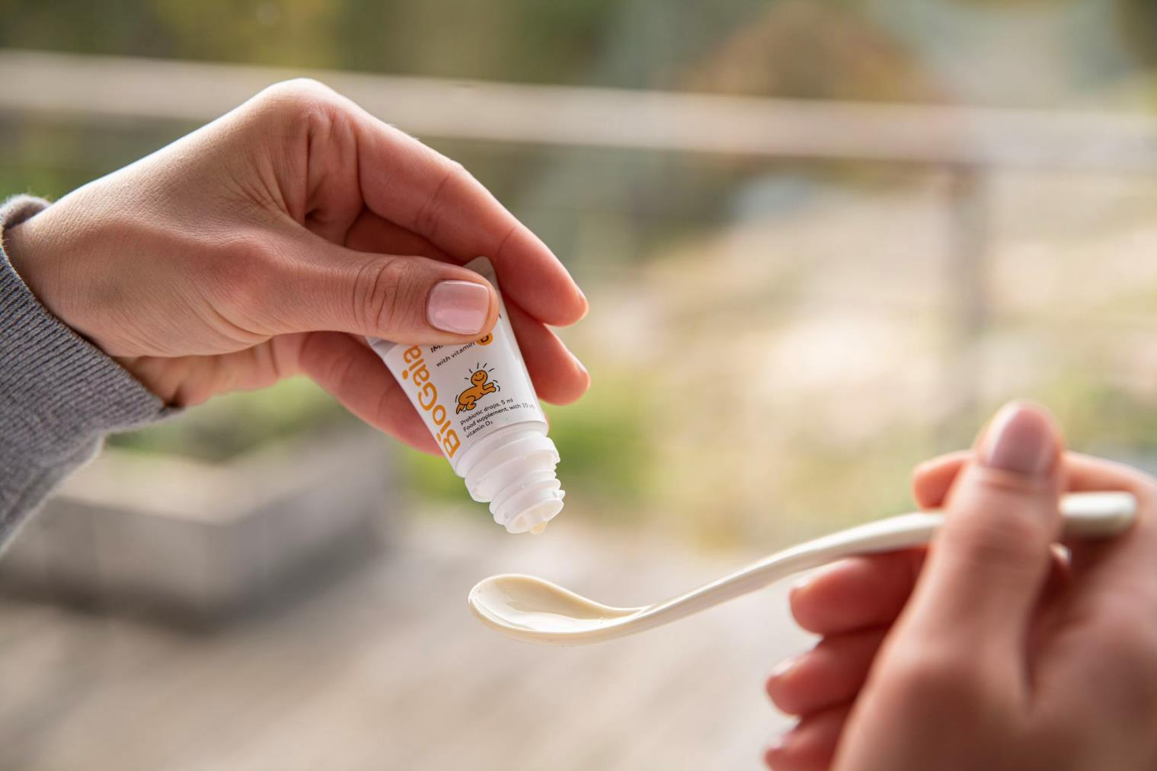
Concluding Remarks
Isabelle Ducellier. CEO

Slide 15
Conclusion
Another strong quarter with +42% growth mainly driven by the lifting of covid restrictions and the wider implementation of our omni-channel retailing strategy of our global premium brand BioGaia
EMEA is continuing its recovery with a strong +86% driven by Italy, France, Spain and Eastern Europe
Americas is performing well due to the acquisition of our distributor Everidis despite weaker sales in Brazil due to phasing of orders. Everdis local sales weak in the quarter due to strong Q2 2021
APAC is continuing its impressive growth thanks to South Korea and China despite China still negatively affected by new lockdowns
This strong quarter again reinforces our confidence for the future of BioGaia. There is a sizeable addressable market that is growing but risks related to challenging macro economics and continued covid restrictions. We will continue our strategy to focus on brand building and scientifically proven probiotics and are confident that we will meet our financial targets

Slide 16
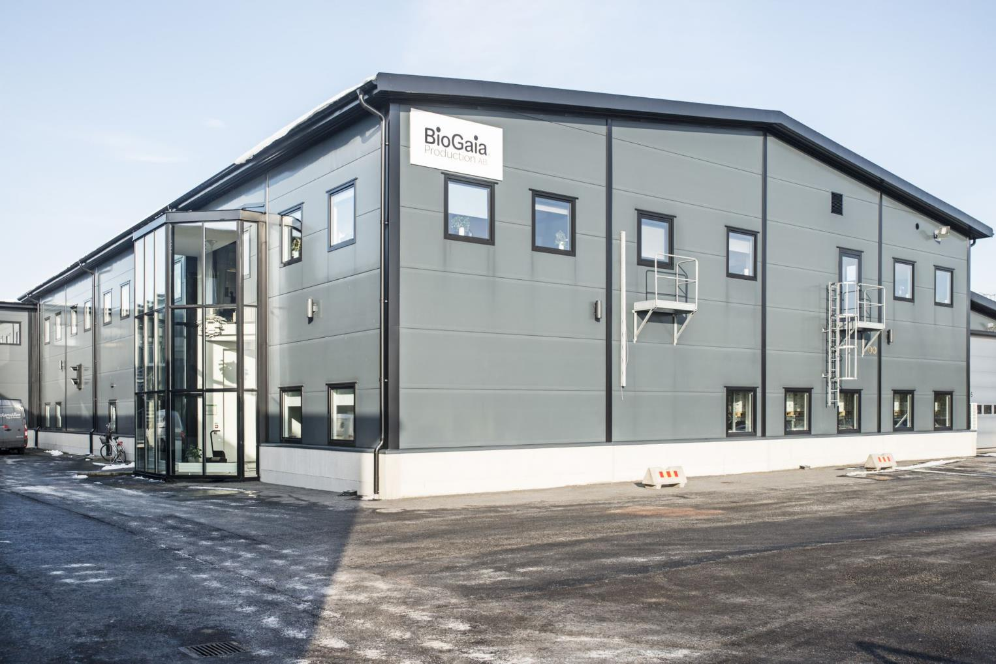
Q&A
Notes:
R12. Nestle som tynger ner egentligen +10% Pediatrics.

